Slide 1
GROUND2026 & 12th LPE
Foz do Iguaçu – September 2026
Format of “ppt” presentations:
Only the first page of the presentation should have the format indicated in the next slide.
See an example in the last slide.
The format of the other pages is free.

Slide 2
GROUND2026 & 12th LPE
Foz do Iguaçu – September 2026
xxxxxxxxxxxxxxxxxxxx Title xxxxxxxxxxxxxxxxxx
xxxxxxxxxxxxxxxxxxxxxxxxxxx
Presenter: Dr. Yyyyyyyy Zzzzzz
Co-author: Prof. Xxxxxx Yxxxxxx Zxxxxxx
xxxxxxxxxxInstitutionxxxxxx
Yyyyyyyyyyyy Zzzzzzzzzz
Country
Photo
See the example in the next page .........

Slide 3
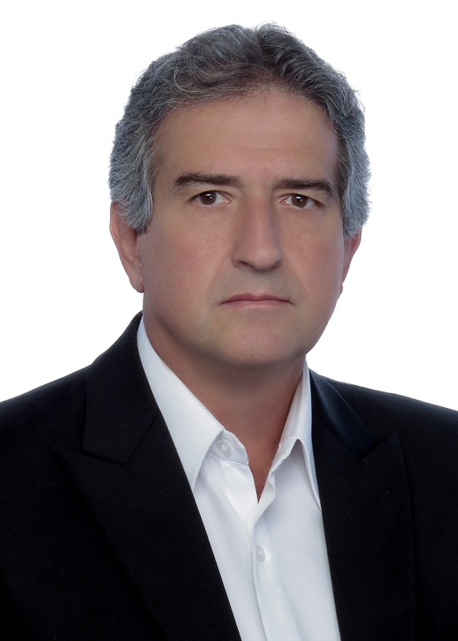
GROUND2026 & 12th LPE
Foz do Iguaçu – September 2026
Measures for Improving the Lightning Performance of Transmission Lines
Presenter: Prof. Silvério Visacro
Co-author: Prof. Fernando H. Silveira
LRC - Lightning Research Center
Federal University of Minas Gerais
Brazil
Photo

